Slide 1
Python making query: https://docs.djangoproject.com/en/3.0/topics/db/queries/
Ref: https://docs.djangoproject.com/en/3.0/topics/db/queries/
Please follow 1 – 5 pre-requite processes
from django.db import models
class Blog(models.Model):
name = models.CharField(max_length=100)
tagline = models.TextField()
def __str__(self):
return self.name
class Author(models.Model):
name = models.CharField(max_length=200)
email = models.EmailField()
def __str__(self):
return self.name
class Entry(models.Model):
blog = models.ForeignKey(Blog, on_delete=models.CASCADE)
headline = models.CharField(max_length=255)
body_text = models.TextField()
pub_date = models.DateField()
mod_date = models.DateField()
authors = models.ManyToManyField(Author)
number_of_comments = models.IntegerField()
number_of_pingbacks = models.IntegerField()
rating = models.IntegerField()
def __str__(self):
return self.headline
1. >> python manage.py createsuperuser
(NOTE just FYI)
2. Access to http://localhost:8000/admin/
3.
Create following code inside models.py
4. Then
>> python manage.py makemigrations
>> python manage.py migrate
5. Confirm open db.sqlite3
6. Just for testing, do following simple two insert statements
insert into blog_blog (name, tagline)
values ('python','programming')
insert into blog_author(name, email)
values ('jini', 'jinibyun@gmail.com')
insert into blog_entry(headline, body_text, pub_date, mod_date, number_of_comments, number_of_pingbacks, rating, blog_id)
values ('headline111', 'this is a body....', '2020-12-31', '2020-12-31', 3, 1, 4, 1)

Slide 2
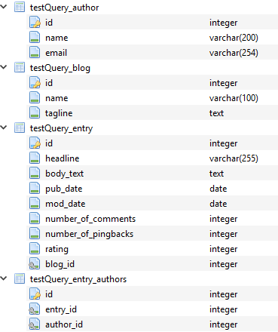
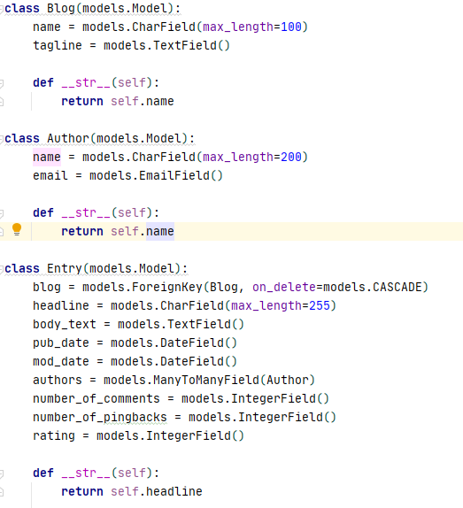

Slide 3
>> Python manage.py shell
(Access to shell mode)
To save
>>> from blog.models import Blog
>>> b = Blog(name="Beatles Blog", tagline="All the latest Beatles news.")
>>> b.save()
To update
>>> b.name = "New Name"
>>> b.save()
>>> from blog.models import Entry
>>> e = Entry()
Saving ForeignKey
>>> from blog.models import Blog, Entry
>>> entry = Entry.objects.get(pk=1)
>>> python_blog = Blog.objects.get(name="python")
>>> entry.blog = python_blog
>>> python.save()
Saveing ManyToManyField fields
>>> from blog.models import Author
>>> joe = Author.objects.create(name="Joe")
>>> john = Author.objects.create(name="John")
>>> paul = Author.objects.create(name="Paul")
>>> george = Author.objects.create(name="George")
>>> ringo = Author.objects.create(name="Ringo")
>>> entry.authors.add(joe, john, paul, george, ringo)
# ===== Retrieving objects
QuerySet API reference
https://docs.djangoproject.com/en/3.0/ref/models/querysets/#queryset-api
Most of time: all(), get(), filter() and exclude()
Field Lookup reference
https://docs.djangoproject.com/en/3.0/ref/models/querysets/#field-lookups
Test
>>> all_entries = Entry.objects.all()
>>> all_entries[0].headline
Test with filter
>>> Entry.objects.filter(pub_date__year=2020) # same as Entry.objects.all().filter(pub_date__year=2020)
>> q = Entry.objects.filter(headline__startswith=“head")
>> q
>> q = q.filter(pub_date__lte=datetime.date.today())
>> q
>> q = q.exclude(body_text__icontains="food")
>> q
Retrieving a single object
>>> one_entry = Entry.objects.get(pk=1)
>> one_entry = Entry.objects.get(pk=-1) # error
NOTE: compare

Slide 4
slicing
>>> Entry.objects.all()[:5]
>>> Entry.objects.all()[5:10]
exact
>>> Entry.objects.get(headline__exact="headline111")
>>> Entry.objects.get(headline="headline111") # same as above
Join
>>> Entry.objects.filter(blog__name=‘python’)
>>> Blog.objects.filter(entry__headline__contains='headline’)
>>> Blog.objects.filter(entry__authors__name='jini’) # no error, no result
>>> Blog.objects.filter(entry__authors__isnull=False)
>>> Blog.objects.filter(entry__authors__isnull=False, entry__authors__name__isnull=False) # no error, yes result
>>> Blog.objects.filter(entry__headline__contains=‘headline', entry__pub_date__year=2020)
exclude
>>> Blog.objects.exclude(entry__headline__contains='headline', entry__pub_date__year=2030)
>>> Blog.objects.exclude(
entry__in=Entry.objects.filter(
headline__contains=‘headline',
pub_date__year=2030,
)
)
Filters can reference fields on the same model
F expression
>>> from django.db.models import F
>>> Entry.objects.filter(number_of_comments__gt=F('number_of_pingbacks’))
>>> Entry.objects.filter(rating__lt=F('number_of_comments') + F('number_of_pingbacks’))
>>> Entry.objects.filter(authors__name=F('blog__name’))
>>> from datetime import timedelta
>>> Entry.objects.filter(mod_date__gt=F('pub_date') + timedelta(days=3))
Pk lookup shortcut
>>> Blog.objects.get(id__exact=1) # Explicit form
>>> Blog.objects.get(id=1) # __exact is implied
>>> Blog.objects.get(pk=1) # pk implies id__exact
>>> Blog.objects.filter(pk__in=[1,4,7])
>>> Blog.objects.filter(pk__gt=1)
>>> Entry.objects.filter(blog__id__exact=3)
>>> Entry.objects.filter(blog__id=3)
>>> Entry.objects.filter(blog__pk=3)

Slide 5
Complex lookup with Q
Abstracts filed lookup
>>> Entry.objects.filter(blog__pk=3)
>>> Q(question__startswith='Who') | Q(question__startswith='What’)
(NOTE: it is same as WHERE question LIKE 'Who%' OR question LIKE 'What%’ )
Refer to document’s example and https://github.com/django/django/blob/master/tests/or_lookups/tests.py
# ===== Deleting objects
>>> Entry.objects.filter(pub_date__year=2005).delete()
# ===== Updating objects
>>> Entry.objects.filter(pub_date__year=2007).update(headline='Everything is the same’)
>>> Entry.objects.all().update(number_of_pingbacks=F('number_of_pingbacks') + 1)
Related Objects
One to many: Foreign Key
(forward)
>>> e = Entry.objects.get(id=1)
>>> e.blog # Returns the related Blog object.
(backward)
>>> b = Blog.objects.get(id=1)
>>> b.entry_set.all() # Returns all Entry objects related to Blog.
>>> b
>>> b.entry_set.filter(headline__contains='headline’)
>>> b.entry_set.count()
(ref)
https://docs.djangoproject.com/en/3.0/ref/models/relations/
Many-to-many relationships
>>> e = Entry.objects.get(id=1)
>>> e
>>> e.authors.all() # Returns all Author objects for this Entry.
>>> e.authors.count()
>>> e.authors.filter(name__contains ='Joe’)
One to one relationships

